Slide 1

Docker project
Submitted by:
Anish garg

Slide 2
About
In this project, I had integrated wordpress and mysql with the help of docker

Slide 3
Summary
In this project I had launched a two different OS using docker, one for wordpress who launch a website using php and another mysql for storing the databases.

Slide 4
Firstly I am going to pull wordpress and mysql from docker hub
TO PULL WORDPRESS
docker pull wordpress:5.1.1-php7.3-apache
TO PULL MYSQL
docker pull mysql:5.7

Slide 5
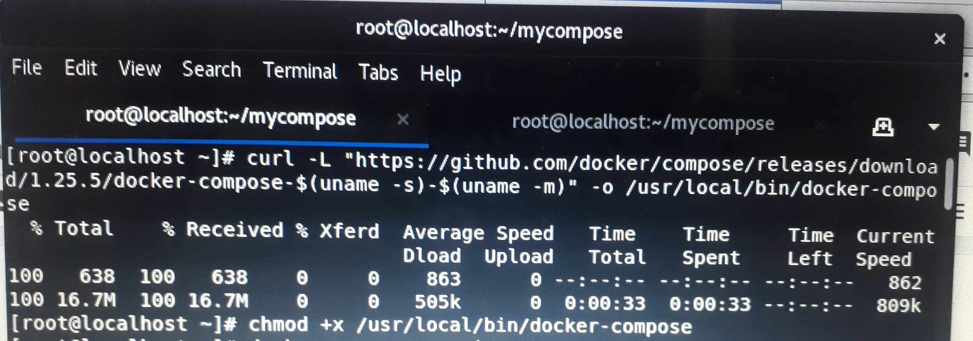
Now I am downloading docker compose binary from Github by running this command and then give permission to this

Slide 6
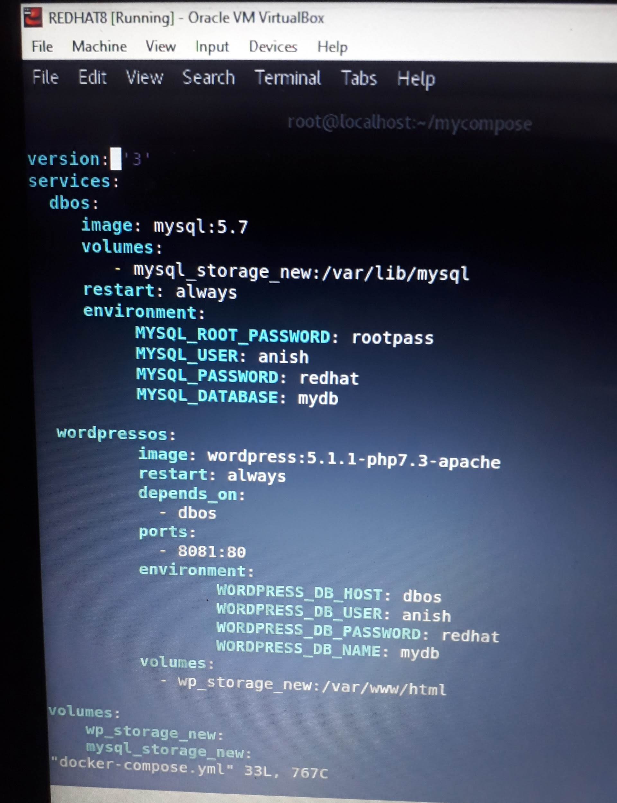
Now, open the yml file for writing the code by using the below command
vim docker-compose.yml

Slide 7
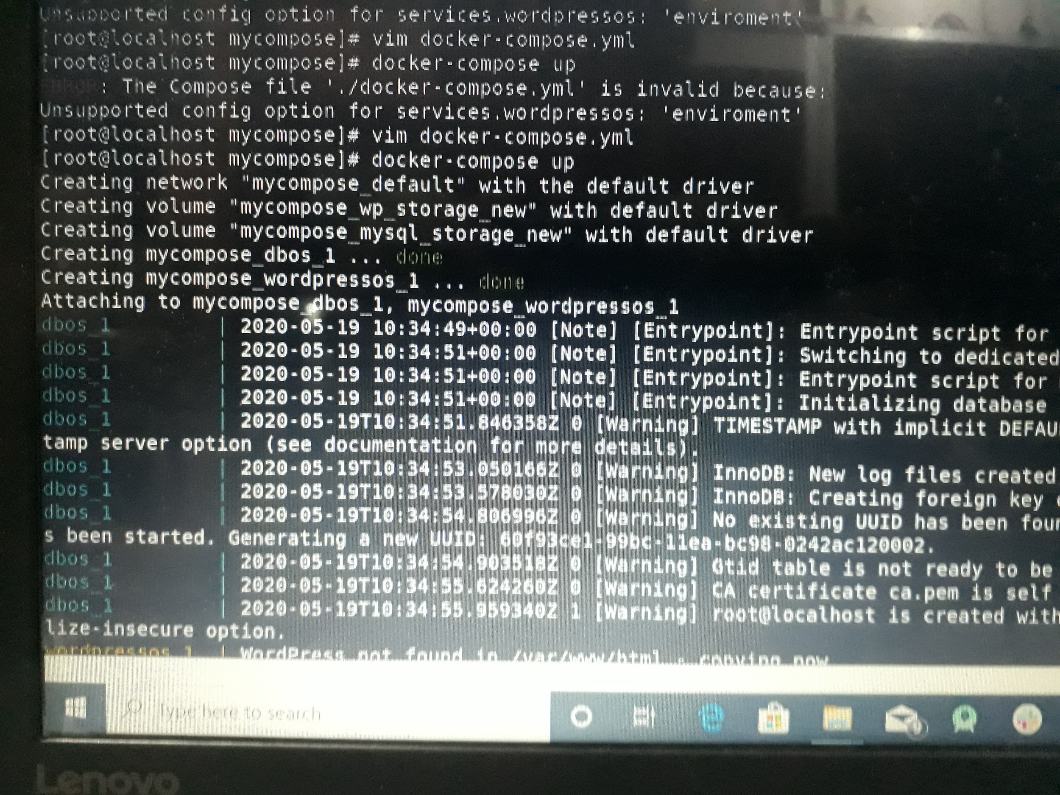
Now run this file by using this command
docker-compose up

Slide 8
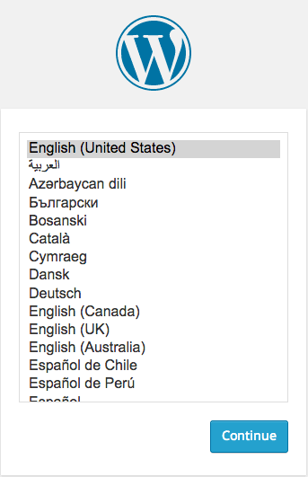
Now open your IP address with port number 8081, you will see Wordpress is successfully launched

Slide 9
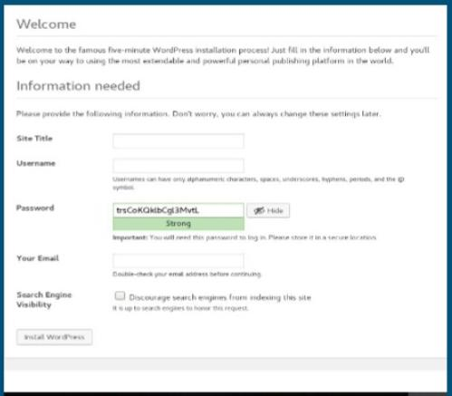
Now enter the following details and make your wordpress account

Slide 10
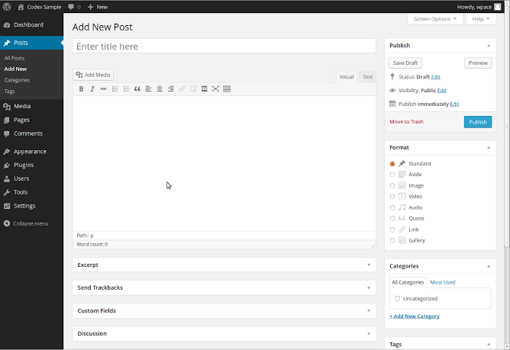
Then, give your title name and give content and then publish to open your website from public network

Slide 11
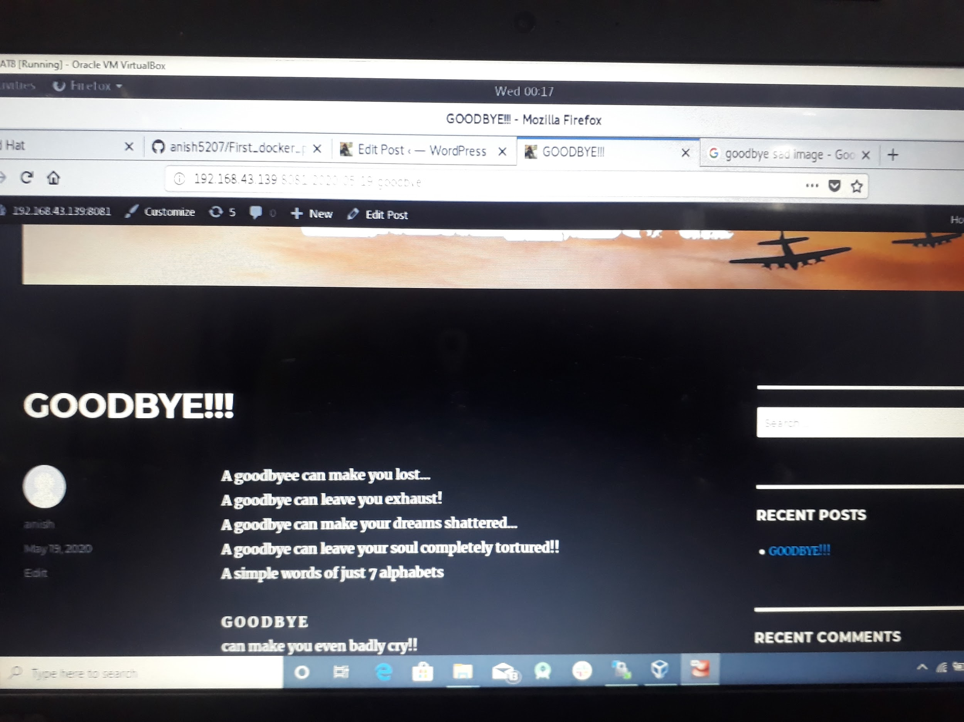
Now, finally publish your site and open the site bye the given url

